Slide 1
i206: Lecture 11:
Stacks, Queues
Marti Hearst
Spring 2012

Slide 2
Outline
What is a data structure
Basic building blocks: arrays and linked lists
Data structures (uses, methods, performance):
  List, stack, queue
  Dictionary
  Tree
  Graph

Slide 3
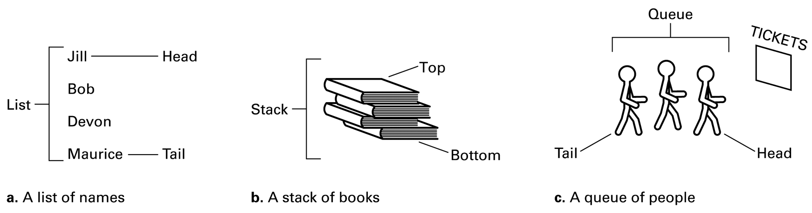
List
An ordered collection of objects
Stacks and queues are special cases of lists
Brookshear Figure 8.1

Slide 4

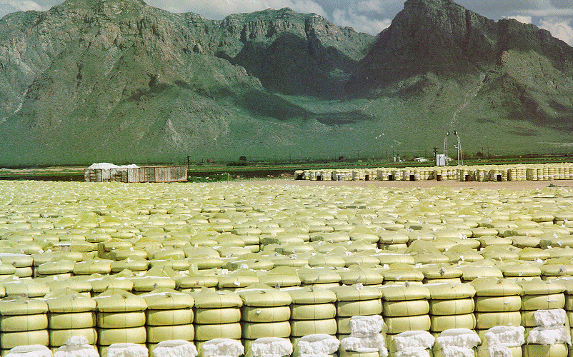


Stacks

Slide 5

Stack
Container of objects that are inserted and removed according to the principle of
  Last-in-first-out
  LIFO
Objects can be inserted at any time, but only the most recently inserted can be removed at any time.
Operations:
  Pop: remove item from stack
  Push: enter item onto stack

Slide 6
Why Stacks?
The Undo facility in software applications
  Is LIFO a good model for this? Why or why not?
The Back button facility in web browsers
  Is LIFO a good model? Why or why not
Certain mathematical calculators (operand stack)
  Makes it easy to do parenthesized expressions
  Example:
    10 Enter (pushes 10)
    30 Enter (pushes 30)
    15 Enter (pushes 15)
    Plus (pops and adds the most recent pair; then pushes the result onto the top of the stack)
    Plus (same as above; end up with 55 as only entry)

Slide 7
Stack Methods
push (o) – Insert an item into/onto the stack
  Input: an object. Output: none.
  If the stack has a fixed size and the stack cannot accept the push, an stack-overflow exception/error is thrown (or returned)
pop() – Returns the most recently inserted object from the stack and removes the object from the stack (an object is removed in last-in-first-out order)
  Input: none. Output: an object.
  If the stack is empty, a stack-empty exception/error is thrown (or returned)

Slide 8
Stack Methods
Auxiliary/Support Methods
  size() – Returns the number of objects in the stack
    Input: none. Output: non-negative integer.
  isEmpty() (or empty()) – Returns true if there are no objects in the stack
    Input: none. Output: true or false
  peek() (or top()) – Returns a reference to (alternatively, a copy of) the most recent item put into the stack
    Input: none. Output: reference to an object (or an object if a copy)

Slide 9
Stack Running Times
What is the running time of each operation?
Push
  O(1)
Pop
  O(1)
isEmpty()
  O(1)

Slide 10
Stack Implementation
In Python, the list can be used as a stack:
  list.append(x)
  list.pop()
Let’s try to implement our own stack as an exercise in understanding what it takes to implement a data structure

Slide 11
Stack Implementation
First review a bit about python lists.
What do these mean if we have an array a = [1,5,7]:
    len(a)
    a[:]
    a[2:]
    a[:2]
    a[0:]
    a[-1]
    a[-1:]
    a[:-1]
    a[len(a):]

Slide 12
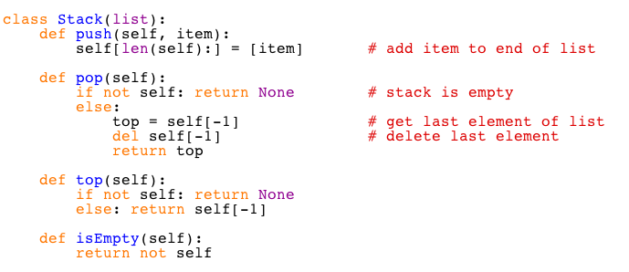
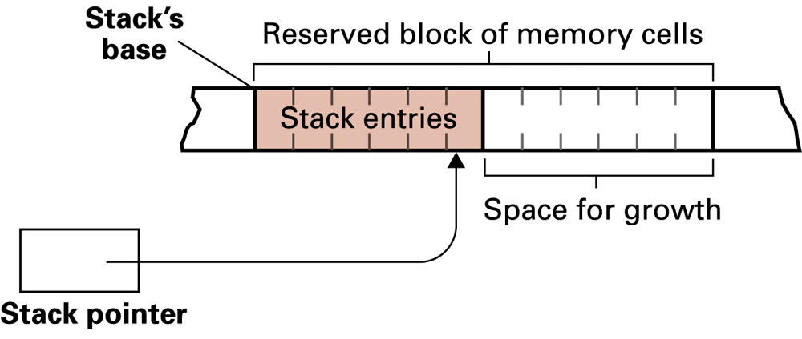
Stack Implementation in Python
Brookshear Figure 8.10

Slide 13
More list fun
  Same effect:
    a[len(a):] = [item]
    a.append(item)
  Different ways to build the same list of numbers:
    s = []
    for i in range(0,9):
    s.append(i)
    s = Stack()
    for i in range(0,9):
    s.push(i)
    s = [i for i in range(0,9)]

Slide 14

Queues
http://www.lib.uconn.edu/DoddCenter/ASC/Wilcox/Students.htm

Slide 15
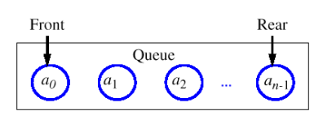
Queue
Container of objects that are inserted and removed according to the principle of
  First-in-first-out
  FIFO
Objects can be inserted at any time, but only the least recently inserted can be removed at any time.
Operations:
  Enqueue: put item onto queue
  Dequeue: remove item from queue

Slide 16
Queue Running Times
What is the running time of each operation?
Enqueue
  O(1)
Dequeue
  O(1)
isEmpty()
  O(1)

Slide 17
Queue Methods
enqueue(item) – Insert the item into the queue.
  If the queue has a fixed capacity, an exception/error will be returned if attempting to enqueue an item into a filled queue.
  Input: item. Output: none.
dequeue() – Returns a reference to and removes the item that was least recently put into the queue (first-in-first-out)
  If the queue is empty, an exception/error will be returned if attempting to dequeue.
  Input: none. Output: item

Slide 18
Queue Methods
size() (or getSize()) – Returns the number of items in the queue.
  Input: none. Output: integer.
isEmpty() – Checks if the queue has no items in it. Returns true if the queue is empty.
  Input: none. Output: true or false.
front() – Returns a reference to the “first” item in the queue (the least recent item). If the queue is empty, an exception/error will be returned if attempting to dequeue.
  Input: none. Output: item.

Slide 19
How are Queues Used?
Queues are used extensively in
  The OS
    For scheduling processes to receive resources
  Computer networking
    For keeping storing and sending network packets

Slide 20
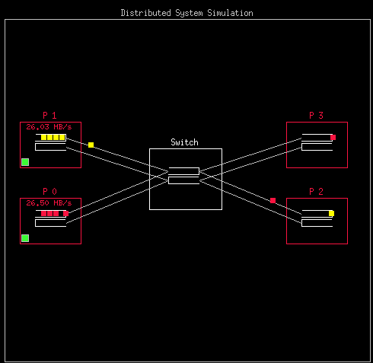
Use of Queues in Distributed Systems
Figure by
Remzi Arpaci-Dusseau

Slide 21
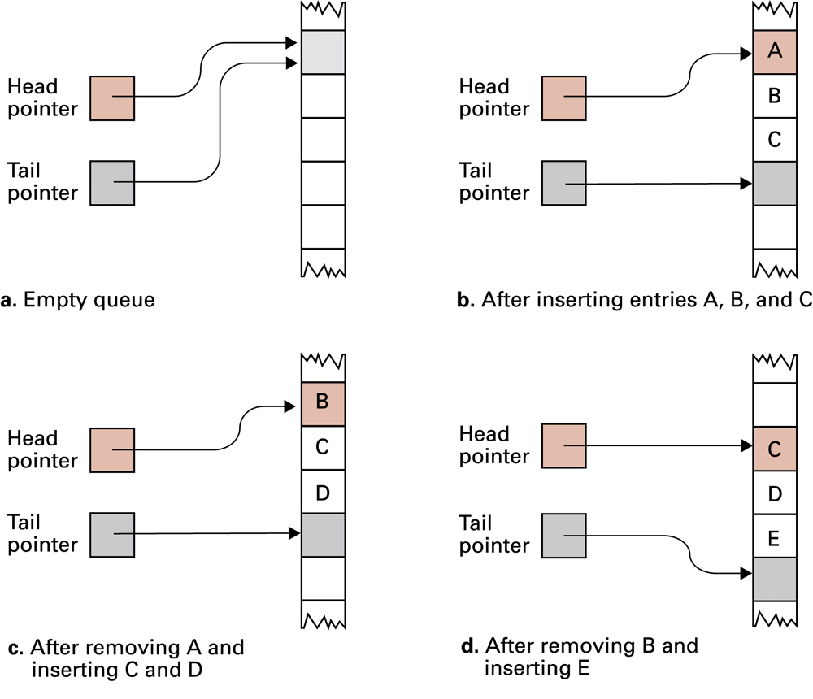
Queue Implementation
In Python, the list can be used as a queue:
  list.append(x)
  list.pop(0)
Brookshear Figure 8.13

